Slide 1

COVID-19

Slide 2

Global Financial Sector Policy Response to COVID-19 Crisis
Julia Gallwitz Aishwarya Puranik Sawani Hejib Trinay Gangisetty Evan McCormick

Slide 3
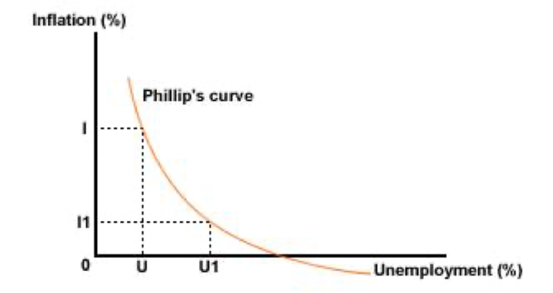
Areas of Application for Data Science in Economics: (Goals)
Impact Evaluation
Risk Management
Fraud Detection
Behavior Modeling
Forecasting

Slide 4



Data Science (and Economics) as a field!

Slide 5
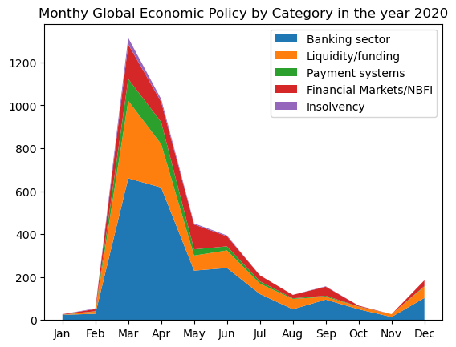

Slide 6
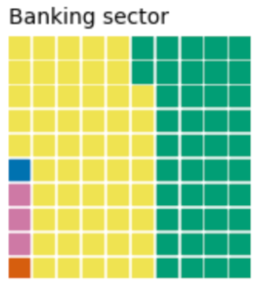
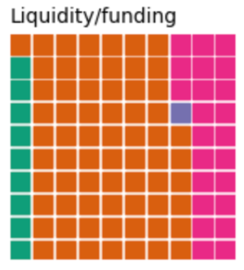
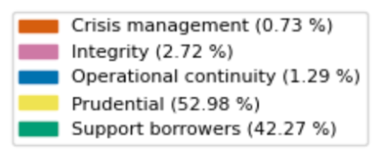
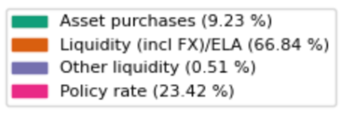
Policy Measure Breakdown by Target Area

Slide 7
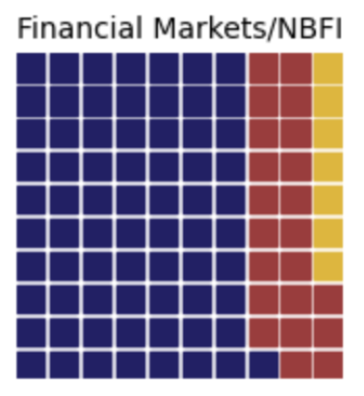
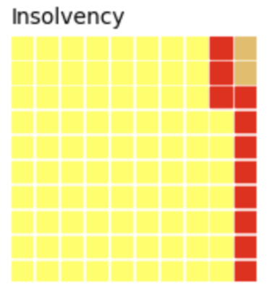
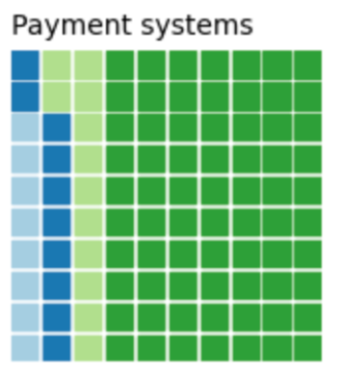
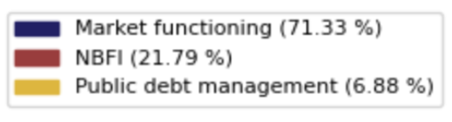
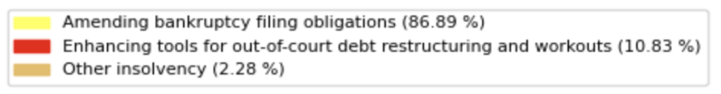
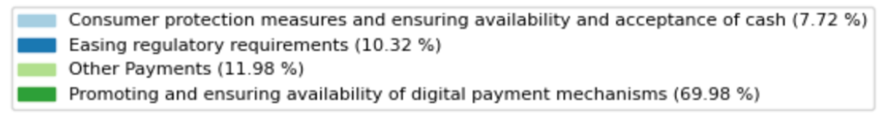
Policy Measure Breakdown by Target Area

Slide 8
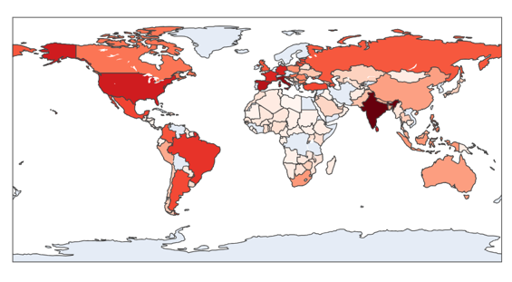
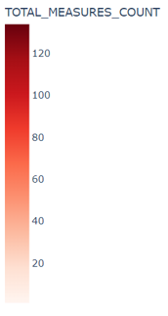
Count of policy measures initiated by each country

Slide 9
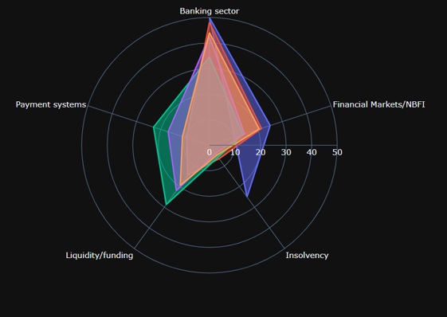
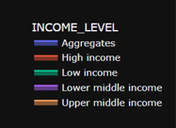
Target Area Breakdown by Income Level

Slide 10
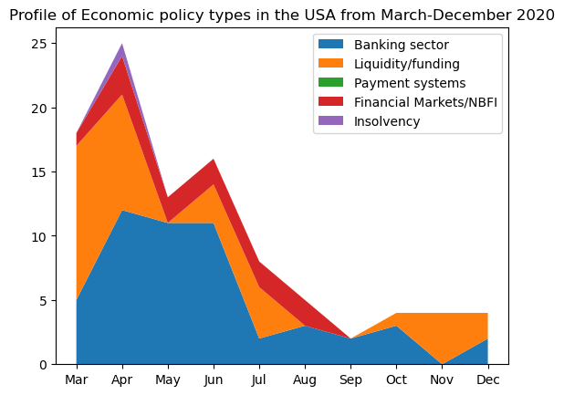
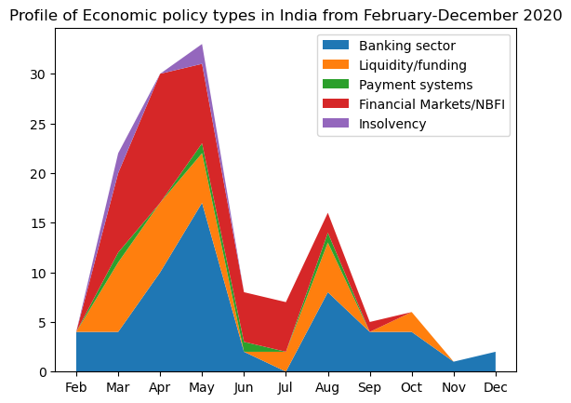

Slide 11
Day-to-Day Responsibilities of a Data Scientist in the field of Economics
Critical and Technical
Collecting the Data
Maintaining the Data
EDA
Training and Testing Models
Evaluating the Impact
Future Forecasting
Other Important Skills
Ask Right Questions
Look at a bigger picture
Critical Thinking
Find the missing pieces
Communicate the Insights

Slide 12
Types of Data Analysis in Economics
Descriptive (What happened ?) - Decision
Diagnostic (Why did it happen?) - Decision
Predictive (What will happen?) - Decision
Prescriptive (What should I do?) - Action

Slide 13
CU Boulder Courses:
ECON 4818: Introduction to Econometrics
ECON 4211: Public Economics: the Economics of the Government Sector
ECON 4413: International Trade
CSCI 5502: Data Mining

Slide 14
References:
What Does a Financial Data Scientist Do? A Complete Guide. CareerFoundry, https://www.facebook.com/careerfoundry/, 30 Mar. 2021, https://careerfoundry.com/en/blog/data-analytics/data-scientist-in-finance/#what-is-a-financial-data-scientist.
Data Science for Finance: Mechanism Examples, benefits. Data Science for Finance: Mechanism Examples, Benefits. (n.d.). https://www.knowledgehut.com/blog/data-science/data-science-for-finance#data-science-applications-in-finance-industry%C2%A0
COVID-19 Finance Sector Related Policy Responses https://datacatalog.worldbank.org/search/dataset/0037999

